Slide 1

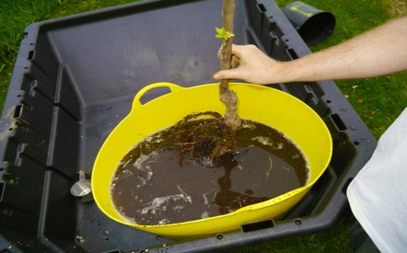
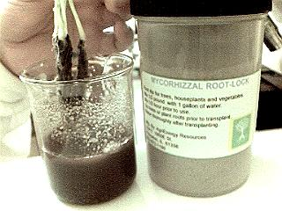
Myco Root Dip
ENDO and ECTO MYCORRHIZAL FUNGI
A DIVERSE BLEND OF NUTRIENTS AND SOIL MICROORGANISMS
THAT AID IN REDUCING TRANSPLANT SHOCK, INCREASE NUTRIENT UPTAKE
ENHANCED WITH A MOISTURE RETENTION AGENT
FOR USE WITH ALL ENDO AND ECTO MYCORRHIZAL PLANTS
INGREDIENTS:
Endomycorrhizal(VAM) species:
Glomus mosseae, Glomus intraradices, Glomus Etunicatum, Glomus clarum, Glomus deserticola, Glomus microaggregatum
Ectomycorrhizal species:
Pisolithus tinctorius, Scleroderma, Rhizopogon
1 LB PER 500 TRANSPLANTS
DIRECTIONS FOR USE:
1. MIX 1 LB WITH 4 GALLONS OF A 50/50 BLEND OF WATER and SP-1 (larger root masses will require more water for thorough coverage).
2. ALLOW BLEND TO STABILIZE FOR AT LEAST 1/2 HR PRIOR TO USE.
3. IMMERSE ROOTS IN SOLUTION PRIOR TO TRANSPLANT.
4. AGITATE WHILE DIPPING ROOTS TO KEEP PARTICLES SUSPENDED
5. ALWAYS WATER EACH TRANSPLANT ADEQUATELY
AGRIENERGY RESOURCES
21417 1950 E ST
PRINCETON, IL 61356
PH 815-872-1190 FAX 815-872-1928
4/18

